Slide 1


Lecture 10
Produced by Dr. Worldwide
Welcome to the 305
~
~

Slide 2

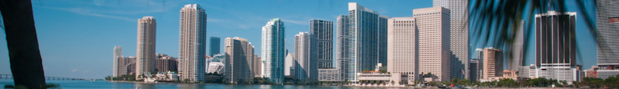
Special Types of Models
Special linear programming problems
Transportation
Transshipment
Assignment
Subset of network flow problems

Slide 3
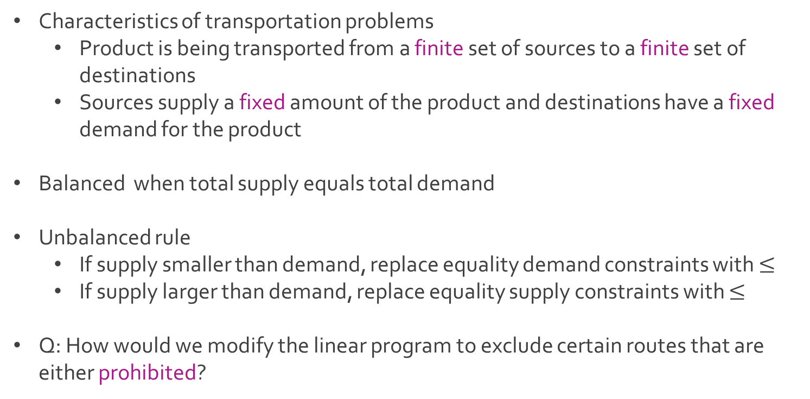
Transportation
Characteristics of transportation problems
Product is being transported from a finite set of sources to a finite set of destinations
Sources supply a fixed amount of the product and destinations have a fixed demand for the product
Balanced when total supply equals total demand
Unbalanced rule
If supply smaller than demand, replace equality demand constraints with $≤$
If supply larger than demand, replace equality supply constraints with $≤$
Q: How would we modify the linear program to exclude certain routes that are either prohibited?

Slide 4
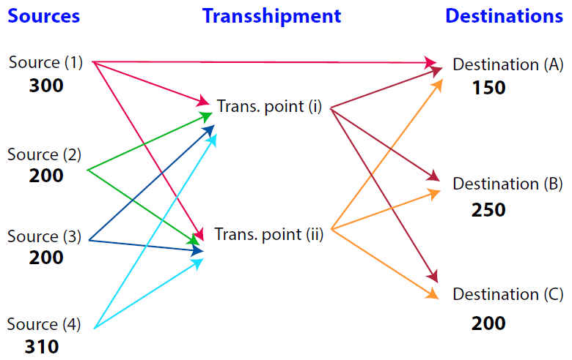
Transshipment
Extension of the transportation model
Diagram of transshipment problem
Q: What is the difference between transportation and transshipment?

Slide 5
Transshipment
Transshipment adds intermediate transshipment points between the sources and the destinations
Possible routes in transshipment models
Sources to transshipment points
Transshipment points to destinations
Sources to destinations
Book also states routes can exist between sources and between destinations
Classic example of transshipment points are warehouses

Slide 6
Ex: Transporting Grain Again
Farms to grain elevators to flour mills
Table of locations
Nebraska and Colorado have become the sources of the wheat
Each of the two farms produces 300 tons of wheat
Kansas City, Omaha, and Des Moines have become our transshipment points
Farms | Grain Elevator | Flour Mills
1. Nebraska | 3. Kansas City | 6. Chicago
2. Colorado | 4. Omaha | 7. St. Louis
 | 5. Des Moines | 8. Cincinnati

Slide 7
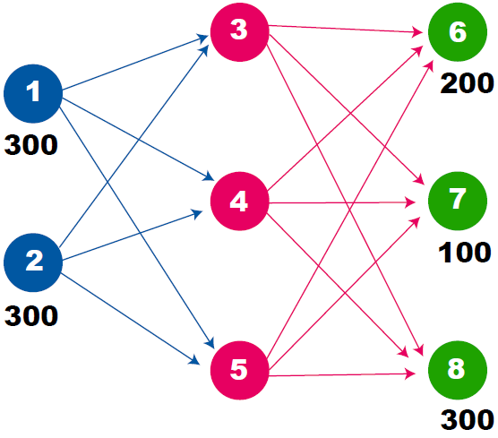
Ex: Transporting Grain Again
General diagram of transshipment problem

Slide 8
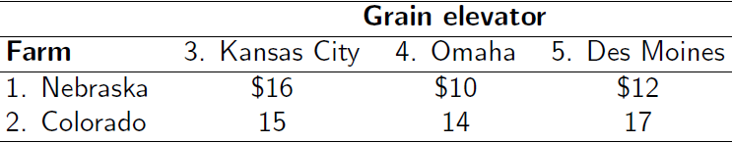
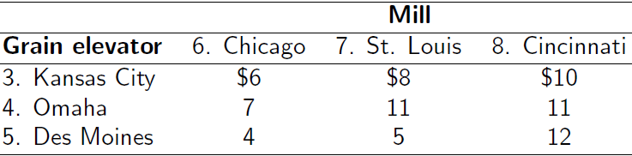
Ex: Transporting Grain Again
Shipping costs from farms to the grain elevators
Shipping costs from grain elevators to flour mills

Slide 9
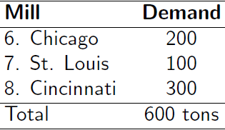

Ex: Transporting Grain Again
Demand from flour mills
Q: How to transport grain (in tons) from farms to flour mills with minimal costs?
Decision variables
$x_{ij}=number of tons of grain to ship from i to j$
$i,j∈\left\{1,2,3,4,5,6,7,8\right\}$ and $i≠j$

Slide 10
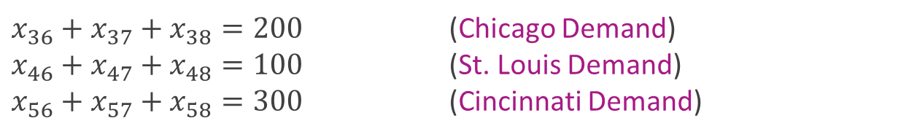
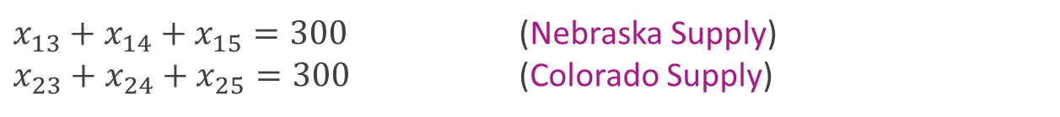
Ex: Transporting Grain Again
Objective function
In this problem, total supply (600) equals total demand (600)
Supply constraints
Demand constraints
$Z=16x_{13}+10x_{14}+12x_{15}+15x_{23}+14x_{24}+17x_{25}$
$+ 6x_{36}+8x_{37}+10x_{38}+7x_{46}+11x_{47}+11x_{48}+4x_{56}+5x_{57}+12x_{58}$
$x_{13}+x_{14}+x_{15}=300$ (Nebraska Supply)
$x_{23}+x_{24}+x_{25}=300$ (Colorado Supply)
$x_{36}+x_{37}+x_{38}=200$ (Chicago Demand)
$x_{46}+x_{47}+x_{48}=100$ (St. Louis Demand)
$x_{56}+x_{57}+x_{58}=300$ (Cincinnati Demand)

Slide 11
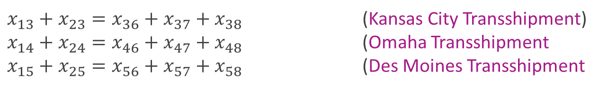
Ex: Transporting Grain Again
Transshipment points have constraints that express equality between what goes in and what goes out
Transshipment constraints
Integer constraints
Download MillsTransship.xlsx from course website from link Sheet 1
Try to find the solution using Excel Solver
$x_{13}+x_{23}=x_{36}+x_{37}+x_{38}$ (Kansas City Transshipment)
$x_{14}+x_{24}=x_{46}+x_{47}+x_{48}$ (Omaha Transshipment
$x_{15}+x_{25}=x_{56}+x_{57}+x_{58}$ (Des Moines Transshipment
$$x_{ij}∈\{0,1,2,⋯\}$$
$$x_{15}=300 \& x_{24}=300 \& x_{48}=300 \& x_{56}=200 \& x_{57}=100$$

Slide 12
Assignment
Similar to the transportation model with slight difference
In the assignment model, the supply at each source and demand at each destination is exactly one
Think of the sources as unique units that need to be assigned to specific recipients
There is cost associated to each pair of source and destination

Slide 13
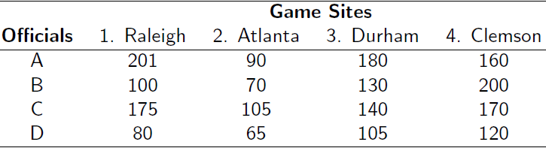
Ex: ACC Officials
Four basketball games in the Atlantic Coast Conference (ACC) on a night
Conference wants to assign four teams of officials to the four games
Supply is always one team of officials
Demand is always requiring only one team of officials
Q: How should we assign the four teams of officials so that distance is minimized?

Slide 14
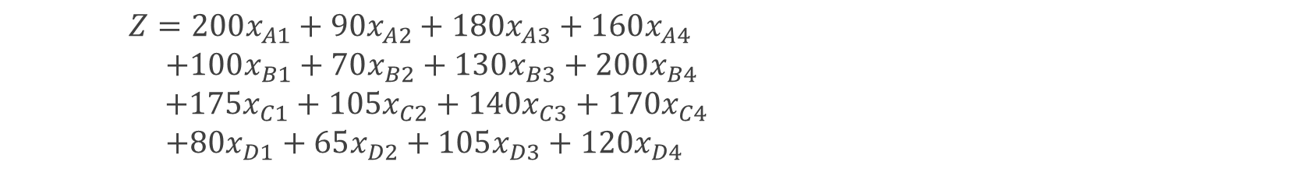

Ex: ACC Officials
Decision variables
$x_{ij}=indicator of whether official team i is assigned to game in city j$
$i∈\left\{A,B,C,D\right\}$
$j∈\left\{1,2,3,4 \right\}$
Objective function
Use multiple choice constraints to ensure supply fulfills demand
$Z=200x_{A1}+90x_{A2}+180x_{A3}+160x_{A4}$
$+100x_{B1}+70x_{B2}+130x_{B3}+200x_{B4}$
$+175x_{C1}+105x_{C2}+140x_{C3}+170x_{C4}$
$+80x_{D1}+65x_{D2}+105x_{D3}+120x_{D4}$

Slide 15
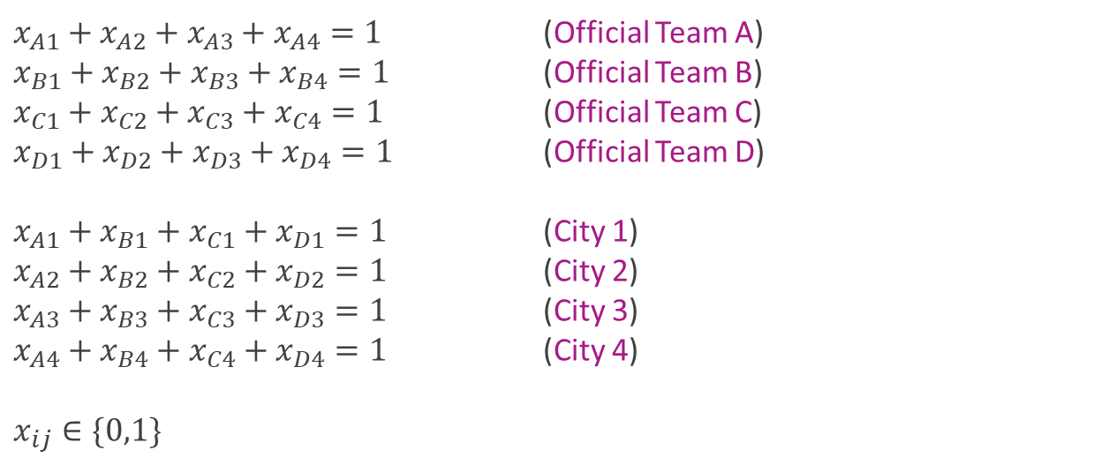
Ex: ACC Officials
Constraints
$x_{A1}+x_{A2}+x_{A3}+x_{A4}=1$ (Official Team A)
$x_{B1}+x_{B2}+x_{B3}+x_{B4}=1$ (Official Team B)
$x_{C1}+x_{C2}+x_{C3}+x_{C4}=1$ (Official Team C)
$x_{D1}+x_{D2}+x_{D3}+x_{D4}=1$ (Official Team D)
$x_{A1}+x_{B1}+x_{C1}+x_{D1}=1$ (City 1)
$x_{A2}+x_{B2}+x_{C2}+x_{D2}=1$ (City 2)
$x_{A3}+x_{B3}+x_{C3}+x_{D3}=1$ (City 3)
$x_{A4}+x_{B4}+x_{C4}+x_{D4}=1$ (City 4)
$$x_{ij}∈\{0,1\}$$

Slide 16
Ex: Give-back Weekend
The Student Government Association (SGA) organizes a recurring event called “Give-Back Weekends” where teams are formed to work on projects for residents in the university community
This event occurs over four consecutive Saturdays in April
Coed teams are formed with 3 to 5 students from various dormitory groups, fraternities, sororities, clubs, and organizations
Residents of the community fill out a form to describe work at their home that needs to be done
Time to complete a project will vary between teams because of the different number of team members, skills of the team, and physical make-up of the team

Slide 17
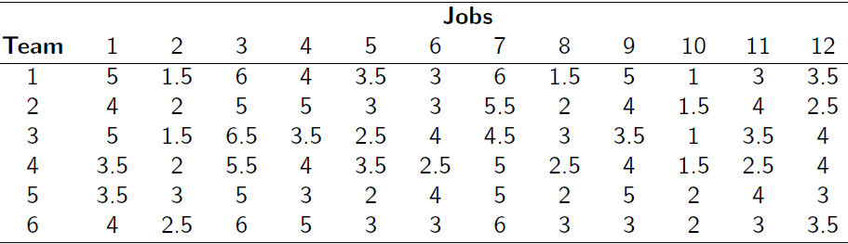
Ex: Give-back Weekend
Time estimates (in hours) submitted by the six teams available to work on 12 different projects for the first Saturday of the event
The primary objective of SGA is to complete all 12 projects

Slide 18
Ex: Give-back Weekend
Teams can work on multiple projects
Teams cannot work more than 8 hours on Saturday
Each team should work on at least one project
Alternative Questions
Q: How can we assign the 6 teams to the 12 projects to maximize the number of jobs completed on Saturday?
Q: How can we assign the 6 teams to the 12 projects to minimize the total time required for all 6 teams?

Slide 19
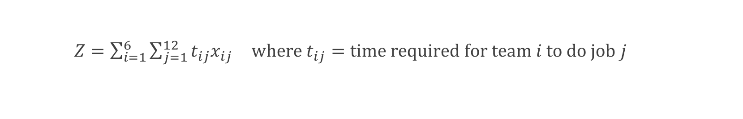
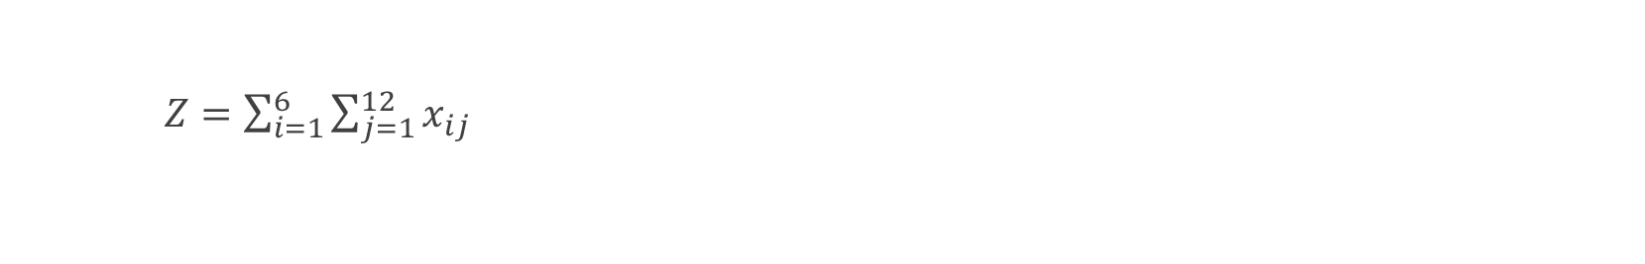
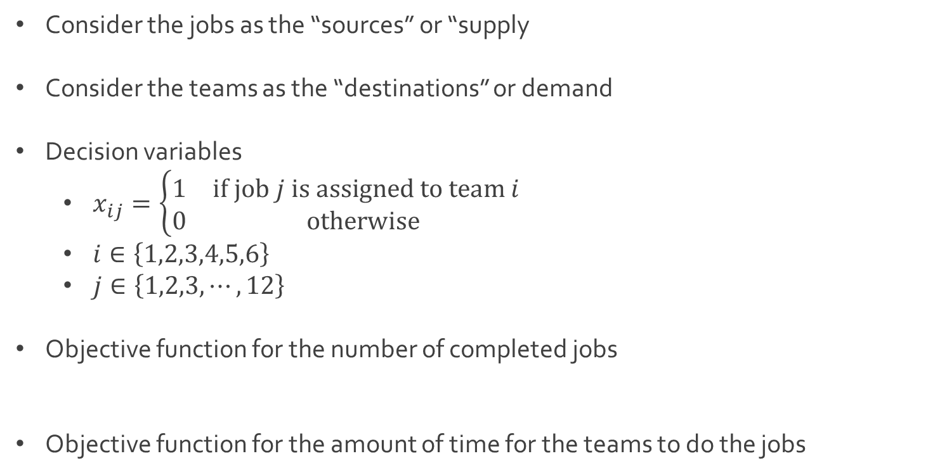
Ex: Give-back Weekend
Consider the jobs as the “sources” or “supply
Consider the teams as the “destinations” or demand
Decision variables
$x_{ij}=\left\{\begin{aligned}\begin{matrix}1 & if job j is assigned to team i \\ 0 & otherwise \end{matrix}\end{aligned}\right.$
$i∈\left\{1,2,3,4,5,6\right\}$
$j∈\left\{1,2,3,⋯,12\right\}$
Objective function for the number of completed jobs
Objective function for the amount of time for the teams to do the jobs
$Z=\sum_{i=1}^{6}{\sum_{j=1}^{12}{x_{ij}}}$
$Z=\sum_{i=1}^{6}{\sum_{j=1}^{12}{{t_{ij}x}_{ij}}} where t_{ij}=time required for team i to do job j$

Slide 20
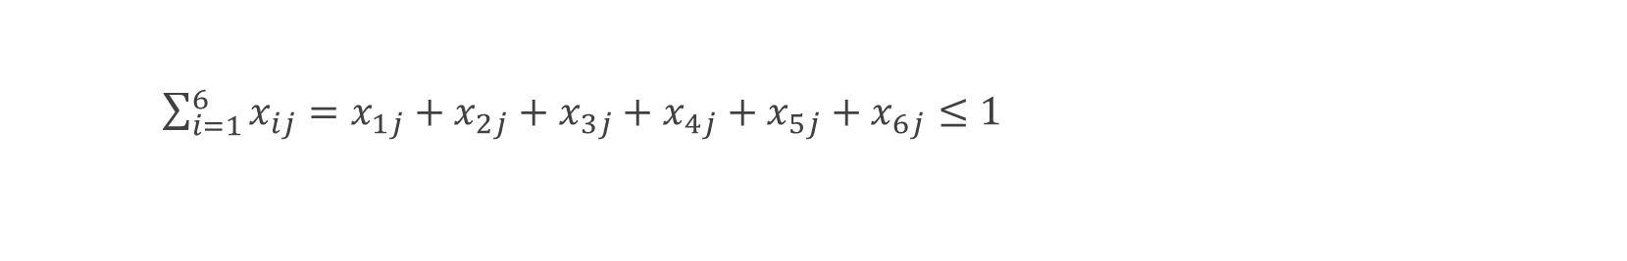
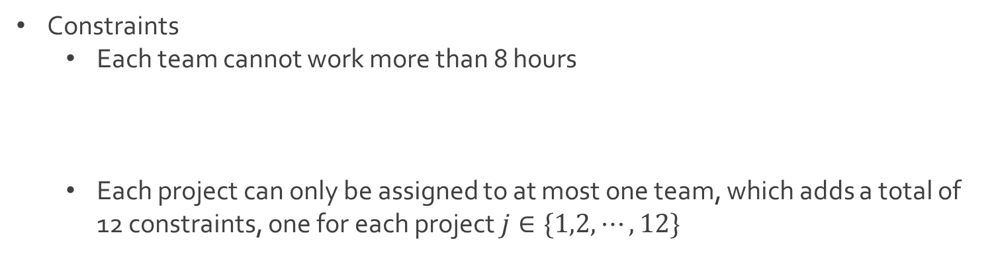
Ex: Give-back Weekend
Constraints
Each team cannot work more than 8 hours
Each project can only be assigned to at most one team, which adds a total of 12 constraints, one for each project $j∈\{1,2,⋯,12\}$
5$x_{11}+1.5x_{12}+6x_{13}+{4x}_{14}+3.5x_{15}+3x_{16}+$
$+6x_{17}+1.5x_{18}+5x_{19}+x_{110}+3x_{111}+3.5x_{112}≤8$(Team 1)
$\sum_{i=1}^{6}{x_{ij}=x_{1j}+x_{2j}+x_{3j}+x_{4j}+x_{5j}+x_{6j}≤1}$

Slide 21




The End
Dale

